Slide 1
Gramener Case Study
Group Member:
Anand kumar
Vikas kumar singh
Narottam kumar

Slide 2
Problem solving methodology using CRISP-DM
Business problem understanding: the requirement of Gramener
Data Understanding: Meaning of each column header from a business perspective
Data Exploration Analysis: Data Cleaning Remove redundant data, unrelated data, imputation etc.
Start
Data Exploration Analysis: Univariate Analysis for Continuous variables(Bar chart $ descriptive stats)
Identification of Continuous vs Categorical Variable.
Save cleaned data as csv: To explore using other tools as well like Tableau, Excel
Data Exploration Analysis: Univariate Analysis for Categorical variables(Histogram $ Line charts)
Data Exploration Analysis: Segmented Univareate Analysis(Using group by & dfply pkg)
Data Exploration Analysis: Bivariate Analysis for Continues variable(Plot scatter charts/correlation Matrices)
Department
Group Three
Data Exploration Analysis: Bivariate Analysis for Categorical variable(Plot scatter charts/correlation Matrices)
Data Exploration Analysis: Identify all important trends that plots convey and document
Customer Presentation & Briefing: Elicit Feedback. Repeat process if necessary
Department
Stop

Slide 3
Business Understanding
Business Objective:
The finance company is looking for the attributes in a applicant profile which can help them is deciding whether to approve or decline the loan application.
Goal of Analysis:
To find out the relation between the different attributes and their impact on loan default. And suggest which attributes contributes a significant difference in Loan Default.
Identification of Loan Applicant traits that tend to ‘default’ paying back.
Understand the ‘Driving Factors’ or ‘Driver Variables’ behind Loan Default phenomena.
Gramener may choose to utilize this knowledge for its portfolio and risk assessment of new loan applicants.

Slide 4
Data Understanding
Types of variables
• Customer (applicant) demographic
• Loan related information & characteristics
• Customer behavior (if the loan is granted)
Customer demographic
Employment length
Employment title
Annual income
Zip code
Description
Loan Information
Loan amount
Funded amount
Interest rate
Loan status
Loan grade
Customer Behavior
Employment length
Employment title
Annual income
Zip code
Description

Slide 5
Data Cleaning and Preparation
Identify all columns that don’t have any other value other than NA
Remove rows and columns where NA values are more than or equal to 30%
Remove irrelevant columns.
Employment Length : Replace null value with 0.
Move all columns that don't change. Justification: There is no variance, it cannot help us to determine the reason for default. We can save memory and analysis, plotting and data frame transformations are faster.
Remove redundant columns. E.g. The purpose of loan is a drop down which is already a categorical variable. We don’t need the title column as it becomes redundant. We can identify all such columns and remove them.
Identify all columns that don’t have any other value other than NA and 0. Remove such columns.
Imputation: Identify all the NA values and replace them with appropriate value. We don’t do this in the master frame but instead as and when that particular column is getting analyzed
Cast all continues variable to numeric variable.

Slide 6
Analysis
Uni-variate Analysis
Continuous Variables
Loan Amount
Interest Rate
Annual Income
Categorical Variables
Loan Status
Purpose of loan
Home Ownership wise Loan
Year wise Loan
Loan Term

Slide 7
Analysis
Bi-variate Analysis
Correlation Matrix : All Continues (Numeric) Variables
Purpose of Loan vs. Loan Amount for each Loan Status
Employment Length vs. Loan Amount for different purpose of Loan
Location vs. Probability Charge Off
Grade / Sub grade vs. Probability Charge Off
Annual Income Range vs. Probability Charge Off
Derived Metrics Analysis
Loan amount to Annual Income ratio
Extract Year & Month from Issue date
Change order of months from Jan to Dec, currently it's in alphabetical order(A-Z)
Create Bins for range of Loan Amount
Create Bins for range of Annual Income
Create Bins for range of Interest rates

Slide 8
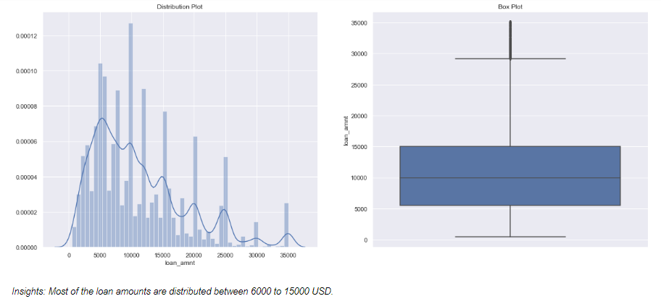
Univariate analysis - Loan Amount
We see that Most of the loan amounts are distributed between 6000 to 15000 USD.

Slide 9
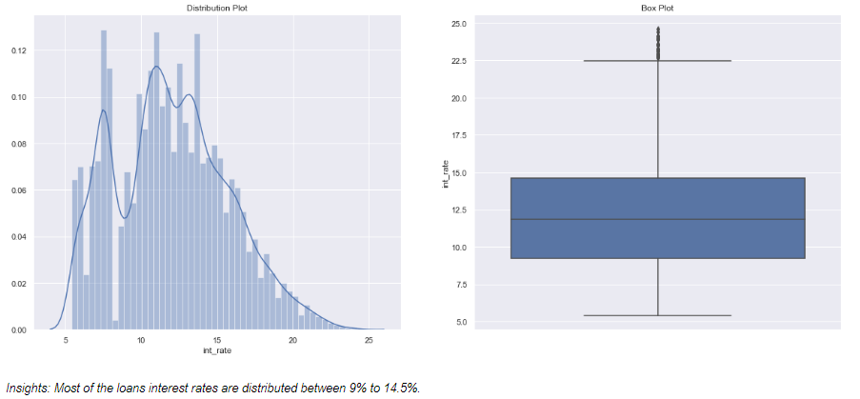
Univariate analysis - Interest Rate
We see that Most of the loans interest rates are distributed between 9% to 14.5%.

Slide 10
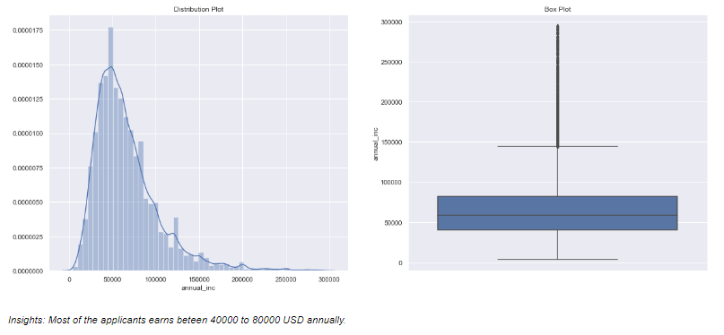
Univariate analysis - Loan Status
We see that Most of the applicants earns between 40000 to 80000 USD annually.

Slide 11
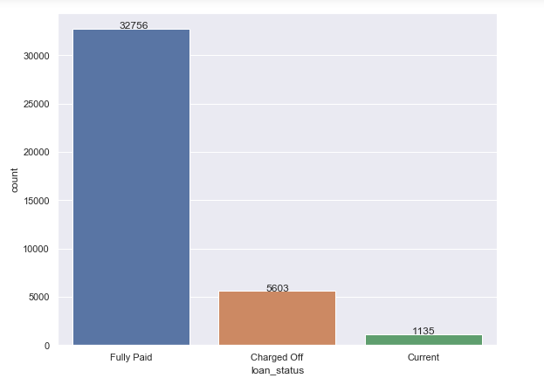
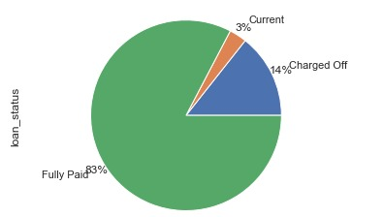
Univariate analysis - Loan Status
We see that : 14% of the applicants Charged off.

Slide 12
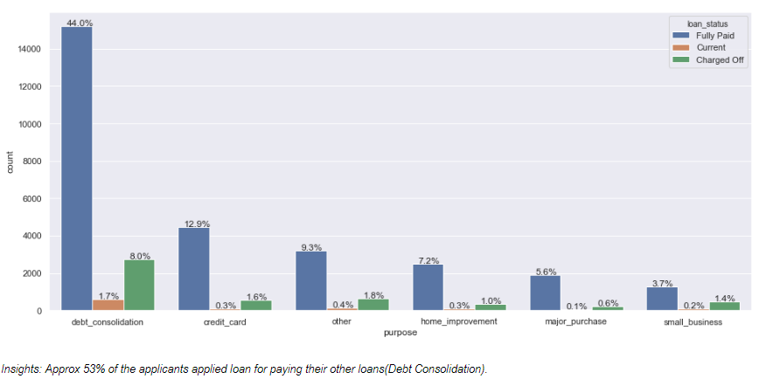
Univariate analysis - Purpose of loan
We see that about 53% of the applicant of loan taken for Debt consolidation

Slide 13
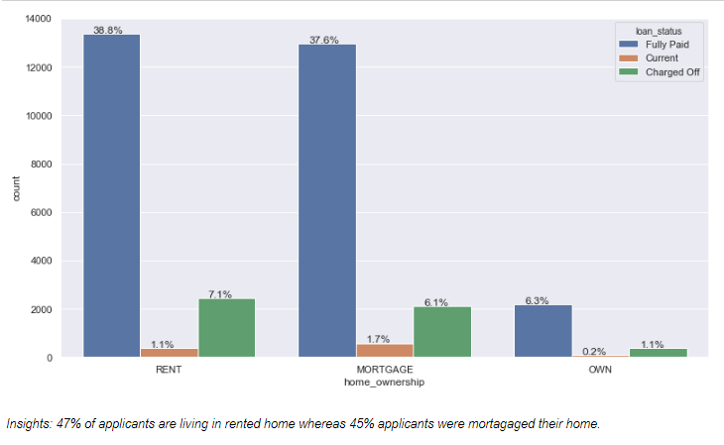
Univariate analysis - Home Ownership Vs Loan
We see that 47% of applicants are living in rented home whereas 45% applicants were mortgaged their home

Slide 14
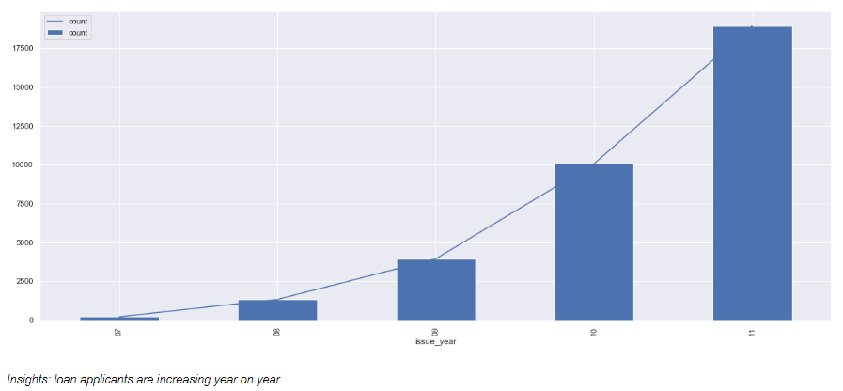
Univariate analysis - Year wise Loan
We see that loan applicants increase during 2010 and 2011year.

Slide 15
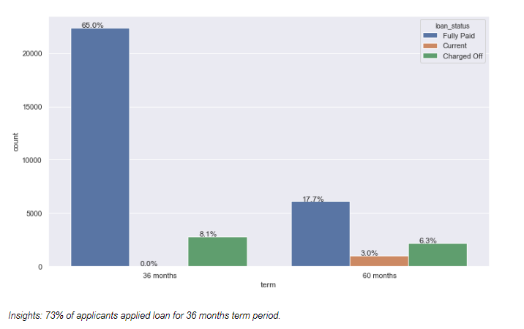
Univariate analysis - Loan Term
Insights: 73% of applicants applied loan for 36 months term period.

Slide 16
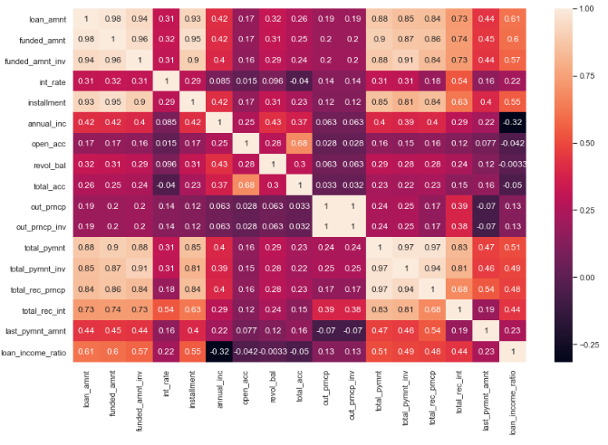
Bivariate Analysis correlation

Slide 17
Bivariate Analysis correlation
We found there is strong correlation between below variable.
Loan amount and funded amount
Funded amount investor and total pay.
Loan amount and total payment
Principal received to date and Total payment
Principal received to date total payment investor
Installment and loan amount
Installment and funded amount
Installment and funded amount inv

Slide 18
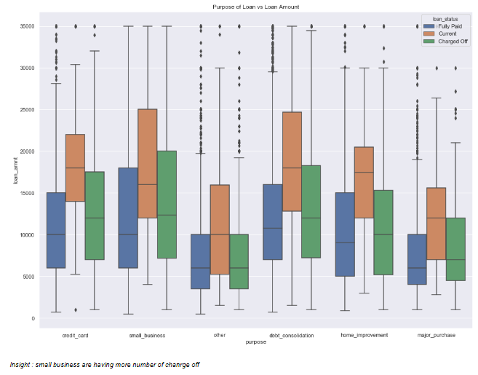
Bivariate Analysis - Purpose of Loan vs Loan Amount for each Loan Status
We see that small business having more number of charged off

Slide 19
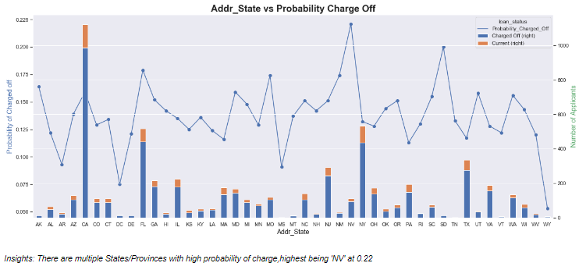
Bivariate Analysis - Location vs Probability Charge Off
We see that multiple States/Provinces with high probability of charged off. Highest being 'NV' at 0.22

Slide 20
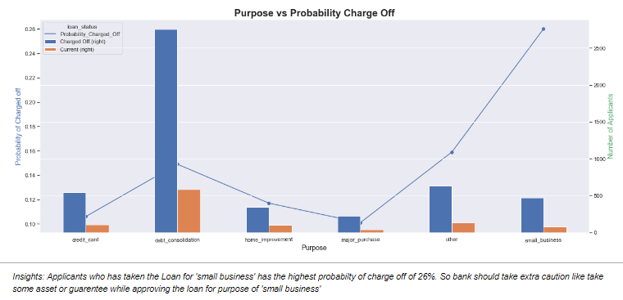
Bivariate Analysis - Loan vs Probability Charge Off
Applicants who has taken the Loan for 'small business' has the highest probability of charge off of 26%. So bank should take extra caution like take some asset or guarantee while approving the loan for purpose of small business

Slide 21
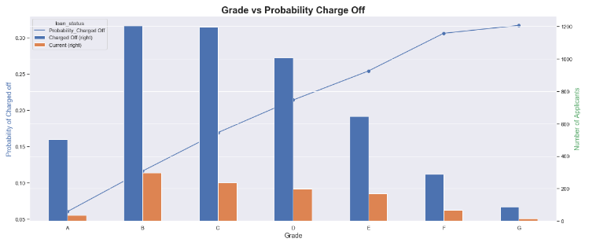
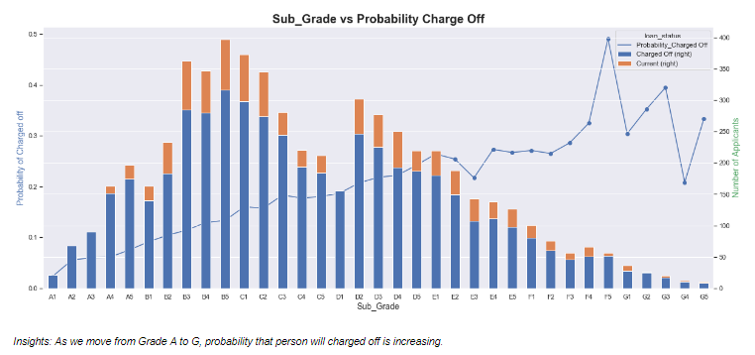
Bivariate Analysis- Grade/Sub grade vs Probability Charge Off
As we move from Grade A to G, probability that person will charged off is increasing

Slide 22
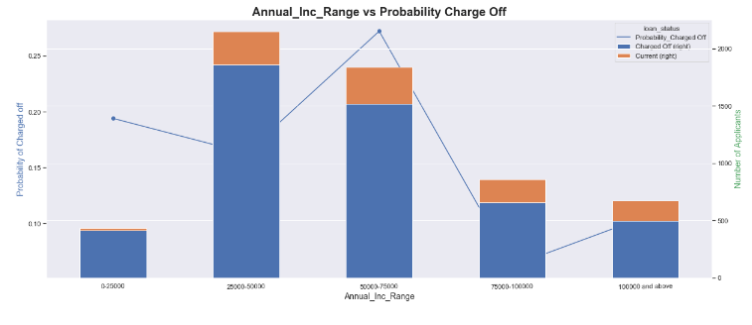
Bivariate Analysis- Annual Income Range vs Probability Charge Off
The probability that person will default is highest of 25% at (50000 to 75000) salary bracket.

Slide 23
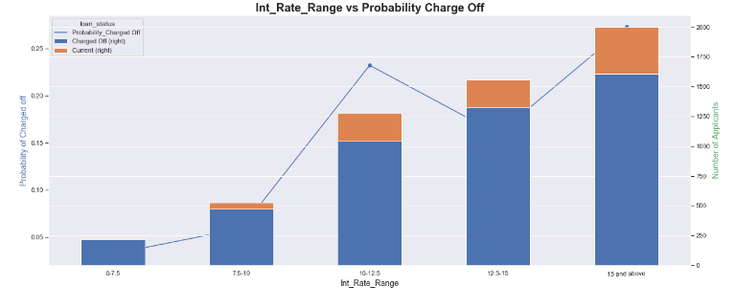
Bivariate Analysis- Interest rate Range vs Probability Charge Off
As the interest rate is increasing the probability that person will default is increasing with highest of 28% at 15 & above bracket.

Slide 24
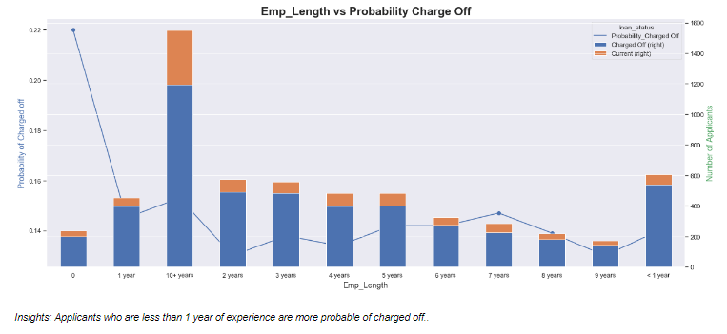
Bivariate Analysis- Employment Length vs Probability Charge Off
Applicants who are less than 1 year of experience are more probable of charged off..

Slide 25
Conclusion:
Giving loan to Depth consolidation is having higher risk as it has around 8% of charged-off
Approving loan to applicant who are having rented or mortgage home is having more risk as we see 7 % and 8% applicant lying under charged off.
We observe 36 month category loan is having 8.1 of charge off list.
We see that small business having more number of charged off.
We see that multiple States/Provinces with high probability of charged off. Highest being 'NV' at 0.22
Applicants who has taken the Loan for 'small business' has the highest probability of charge off of 26%. So bank should take extra caution like take some asset or guarantee while approving the loan for purpose of small business.
As we move from Grade A to G, probability that person will charged off is increasing
The probability that person will default is highest of 25% at (50000 to 75000) salary bracket.
Applicants who are less than 1 year of experience are more probable of charged off.

